Slide 1
Multi-Task Regression-based Learning for Autonomous Unmanned Aerial Vehicle Flight Control within Unstructured Outdoor Environments
Kavyashree Devadiga
UID. 117398045
Naitri Rajyaguru
UID. 117361919
Under the guidance of Dr. Waseem Malik

Slide 2
Idea
Implement a multi-task learning (MTL) based autonomous UAV systems to improves prediction accuracy and the inductive transfer approach leads to a highly generalized system.
The autonomous flight control system is generalized can be deployed for any surveillance, or search application without the direct intervention of a human operator

Slide 3
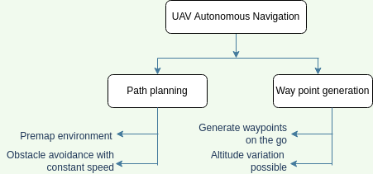
Existing systems
Current systems either need pre-constructed map or depend on GPS for waypoint navigation.
Navigation methods currently used

Slide 4
Implementation
Handles applications where the environment is unstructured, the environment is unknown beforehand, and GPS denied environments.
The network extracts features from the image and passes it over two sub-networks for the prediction of rotational and translational value
Control module consists of Rate control and Attitude control.

Slide 5
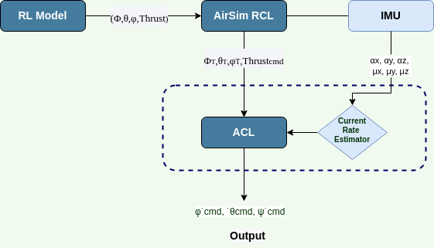
Control System

Slide 6
Rate Control (RCL)
Generates commands to manipulate the change in velocities and thrust of the UAV motors
Control in terms of North-East-Down (NED) values in meters and the rotation and orientation in terms of a quaternion tuple : roll, pitch and yaw ( Φ¯ ,θ¯,ϕ¯)
The output from network is fed into the RCL. The RCL generates the target rates quaternion

Slide 7
Attitude control (ACL)
Controlling the orientation of an air vehicle taking into consideration the current attitude of the vehicle and the desired attitude
Consists of a module that estimates current rates based on the readings from the Inertial Measurement Unit (IMU) (αx,αy,αz ,µx,µy,µz).
The motion commands are in terms of Φ˙ cmd,θ˙ cmd,ϕ˙cmd
(Φ˙ cmd,θ˙ cmd) are then converted to PWM signals to control actuators on UAV

Slide 8
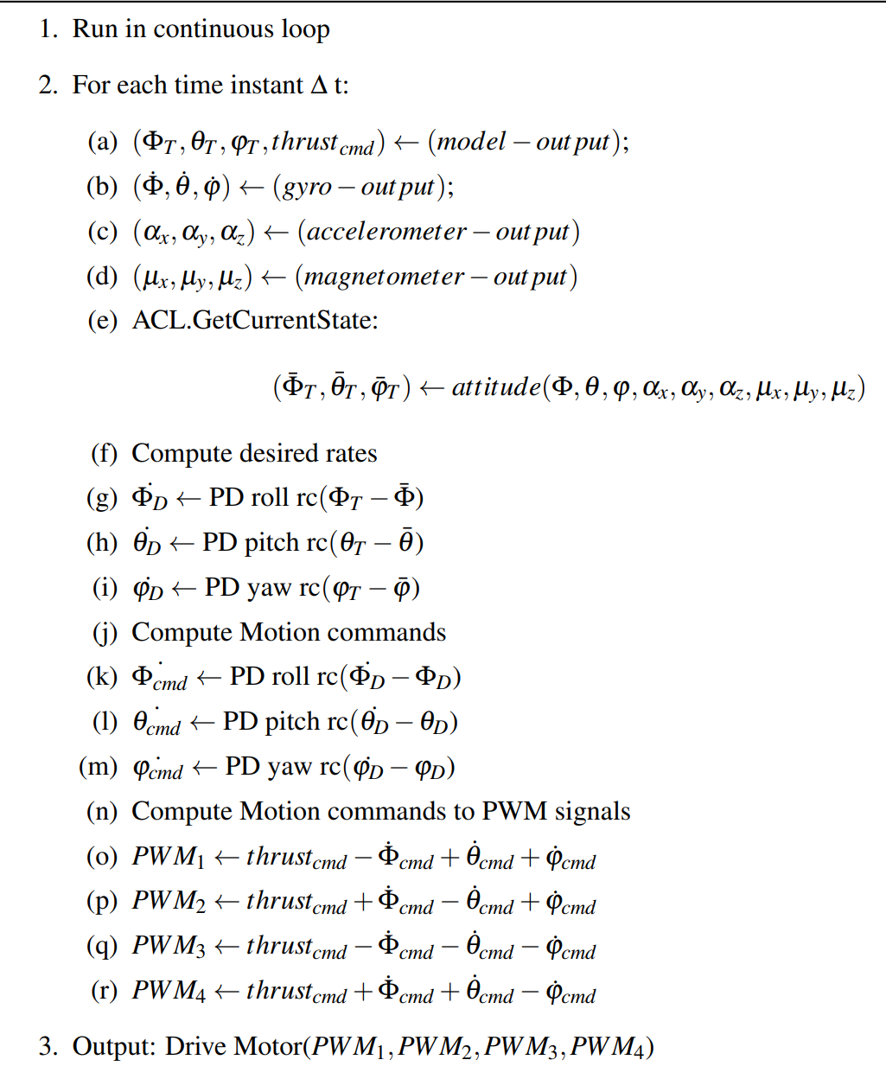
Algorithm

Slide 9
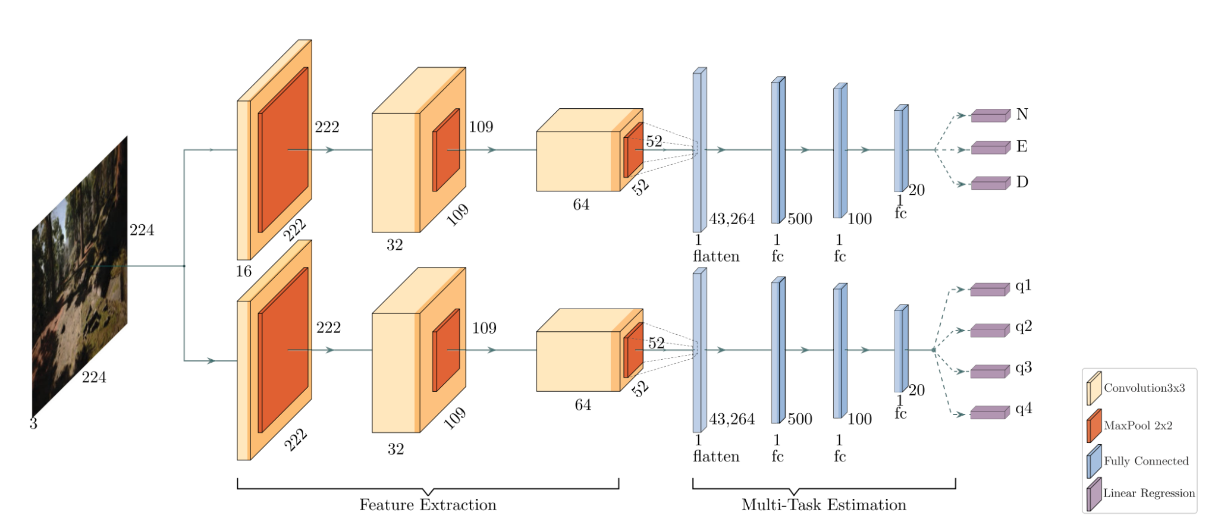
Network
CNN Network

Slide 10
Dataset
AirSim
The dataset is collected manually by flying the UAV in Airsim Redwood Forest Environment where in total 81,674 frames were captured
In this project we are using the dataset generated by original authors.
AirSim (Aerial Informatics and Robotics Simulation) is an open-source simulator that supports software in the loop simulation for drones, cars, and more with visually realistic simulations.
We are using AirSim to simulate our output.

Slide 11
Blender
Blender is an open-source computer graphics software used for creating films, visual effects, art, and more.
We created a forest scene in Blender and implemented the original algorithm on this environment.
The dataset and model was originally created in AirSim, but we got fairly accurate result which proved our environment-agnostic model

Slide 12
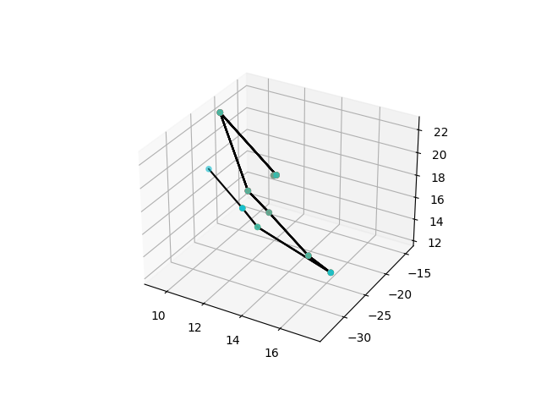
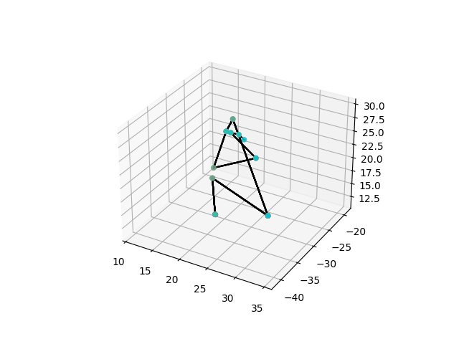
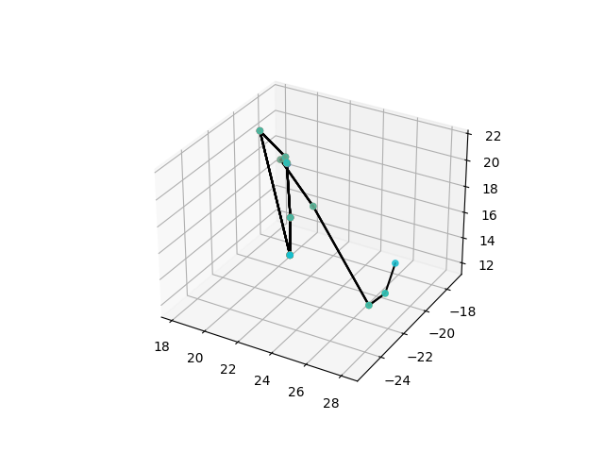
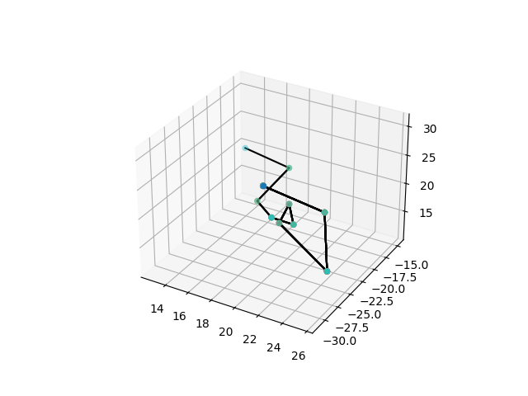
Results
Waypoint plots are as follows
Africa environment
Zhing environment
Snowy mountain environment
MS Build environment

Slide 13
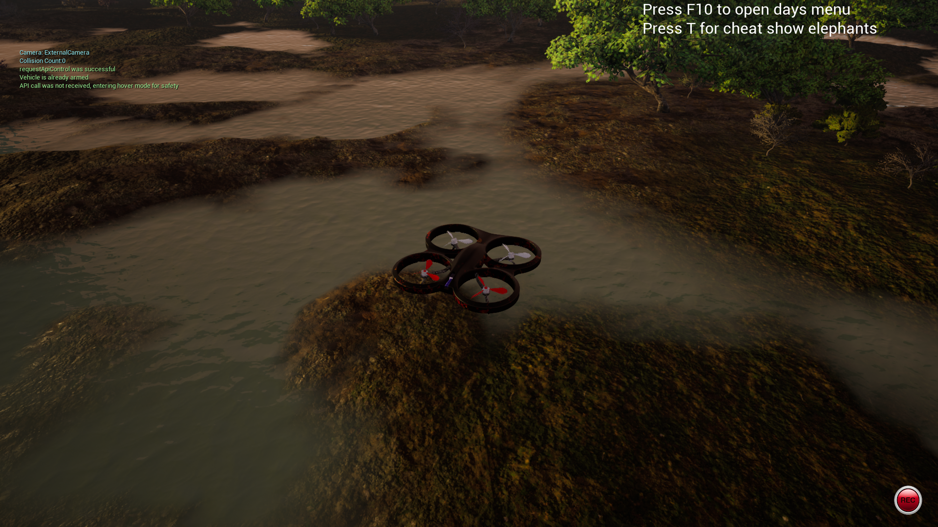
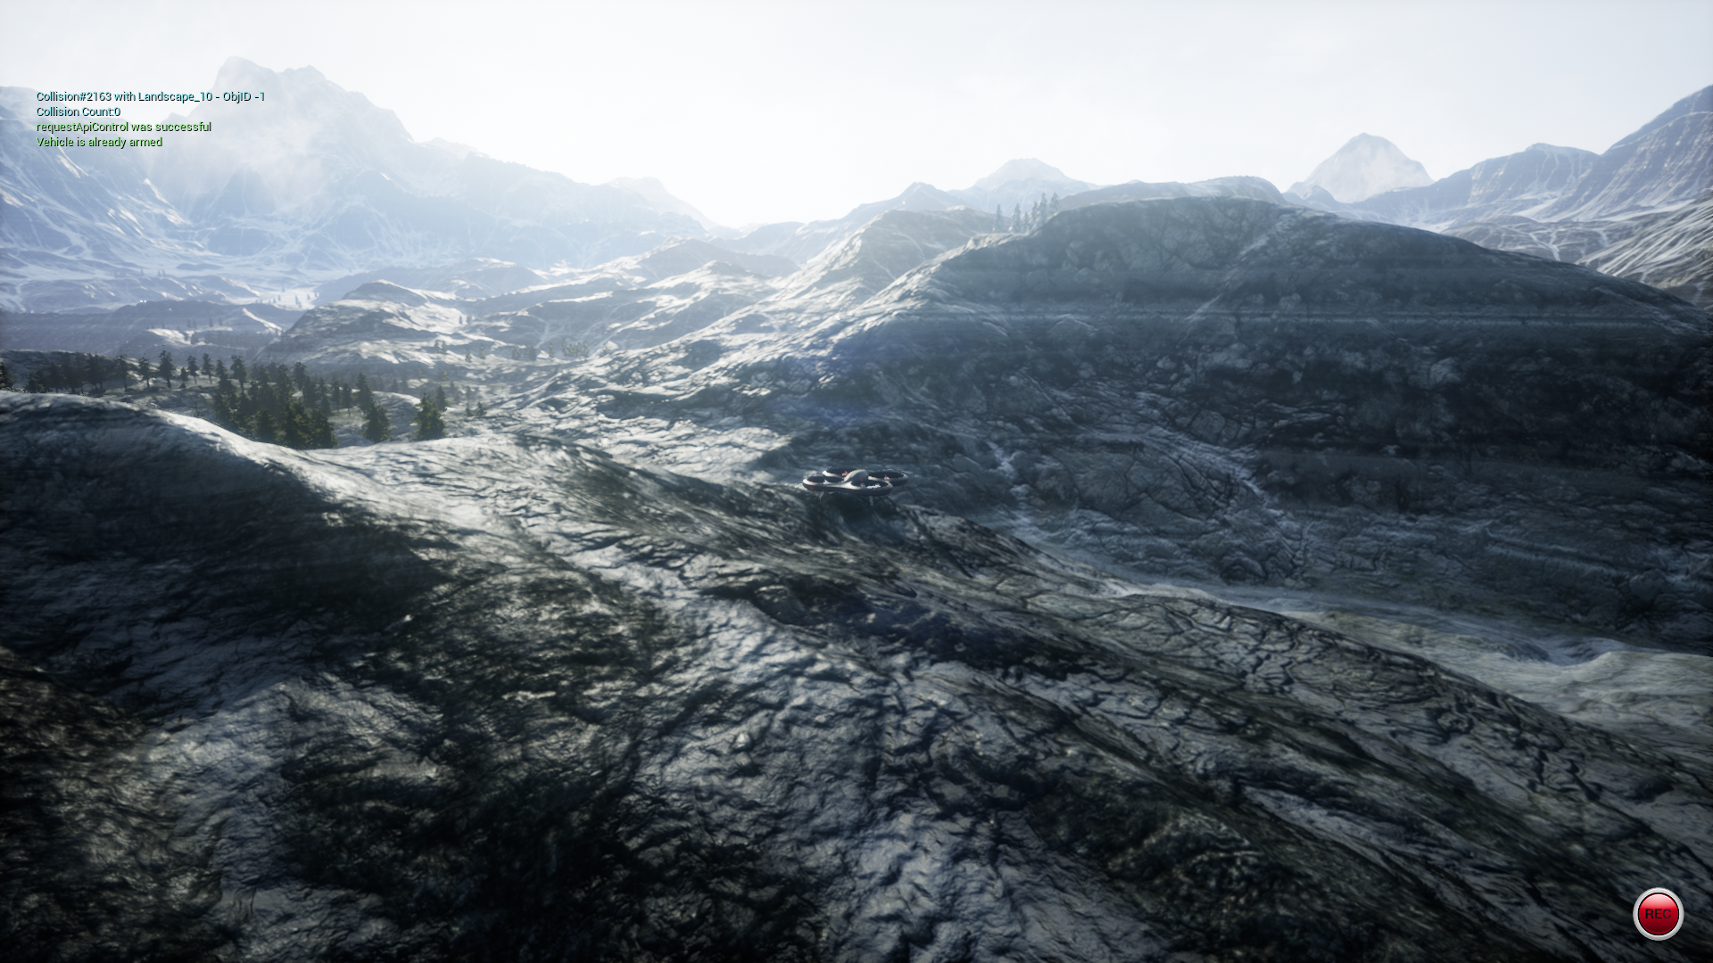
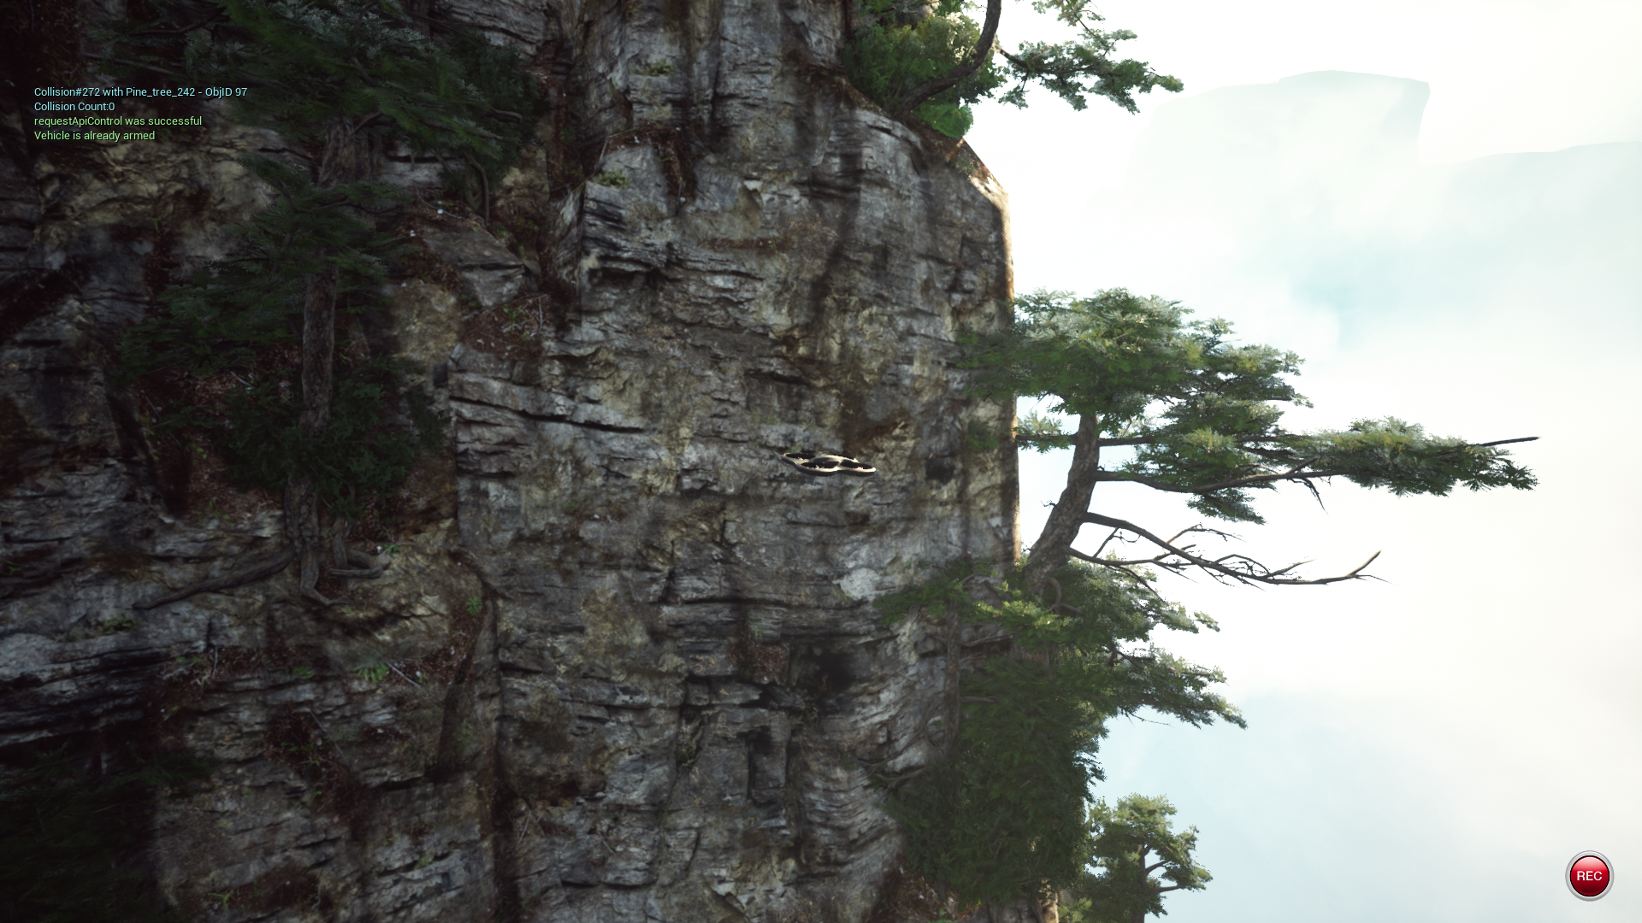
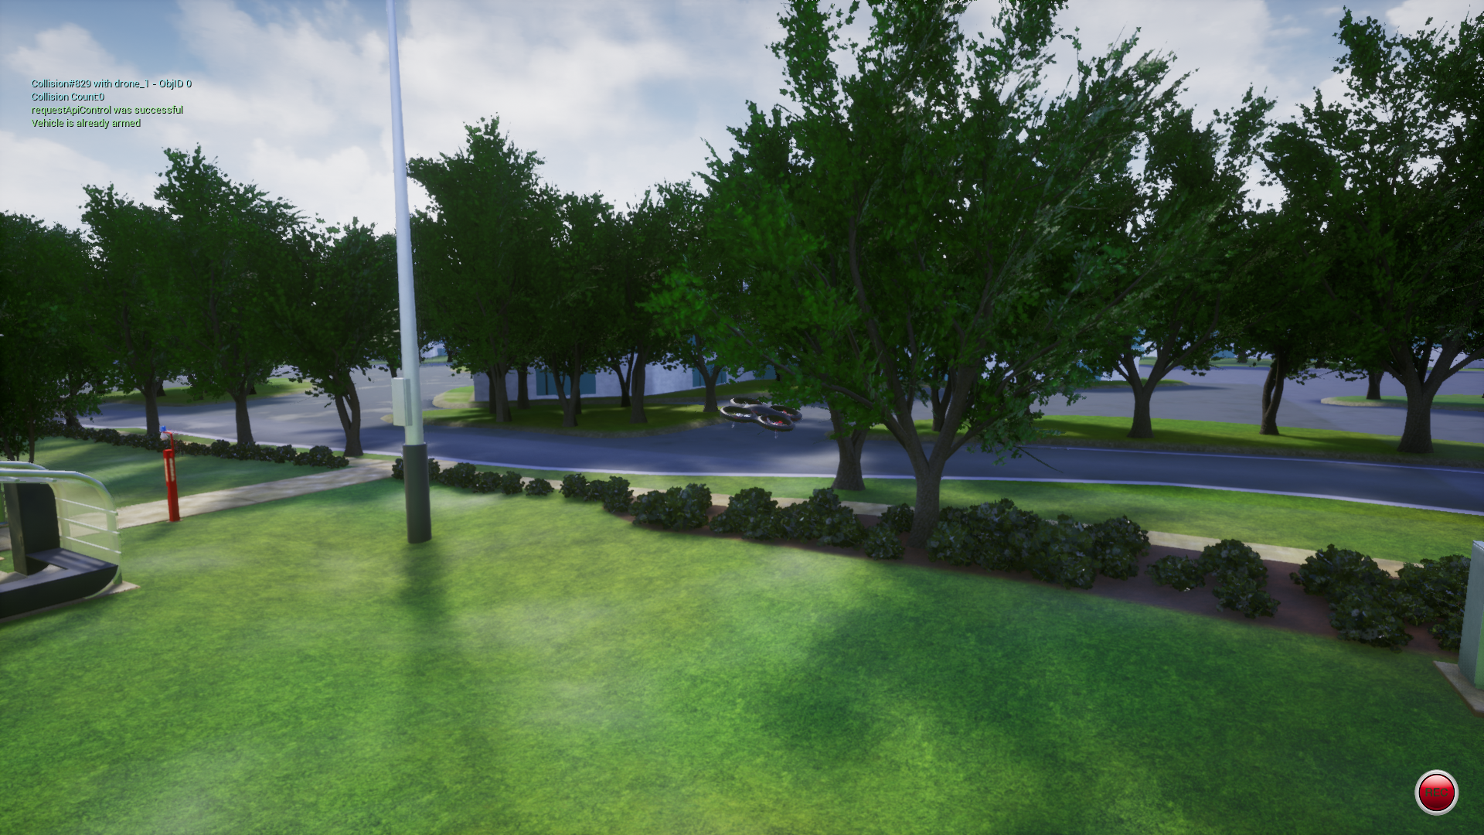
Simulations

Slide 14
Conclusion
We successfully studied the Multi-Task Regression-Based Learning for Autonomous Unmanned Aerial Vehicle Flight Control Within Unstructured Outdoor Environments paper and verified its results by implementing the project. Simulations done is different environment prove that the proposed system is robust to implement obstacle avoidance and flight control is any environment. The environment agnostic property of the model is a feature not seen in the already existing algorithms and implementations in this area.

Slide 15
Links
Original Paper
GitHub repository
Demo

Slide 16
Thank you

